Slide 1
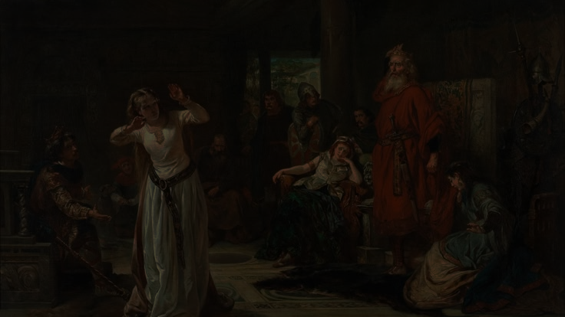
Drama Presentation
Presented by - Group 2
List of Team Members:
Sl No. | Name | ID
1 | Irshia Haque | 2025-2-60-067
2 | Nabil Arefin | 2025-2-60-068
3 | Md.Ashikur Rahman | 2025-2-60-070
4 | Tasnin Ahammed | 2025-2-60-072
5 | Nirod Mahmud Turjo | 2025-2-60-074
6 | Sharia Ibtesham | 2025-2-77-096
7 | Jannatul Ferdous | 2025-2-77-166

Slide 2
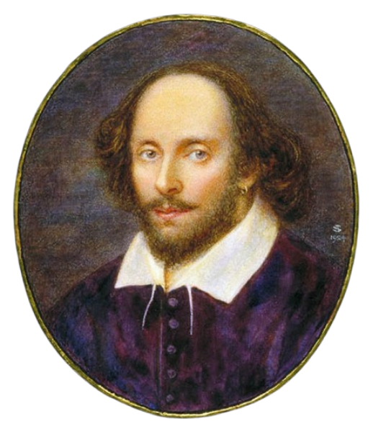
Introduction
King Lear is a renowned tragedy by William Shakespeare.
The play chronicles the story of an elderly monarch who chooses to distribute his kingdom among his three daughters.
This pivotal decision results in a sequence of betrayal, madness, and ultimately, tragic death.

Slide 3
Setting of the Drama
The narrative is set in ancient Britain.
Principal locations depicted include:
King Lear’s Royal Court
The castles belonging to his three daughters
The storm-ravaged heath, which powerfully symbolizes chaos and psychological turmoil

Slide 4
Themes of the Drama
Central themes explored within the play are:
The nature and abuse of power and authority
Betrayal versus loyalty among family and subjects
The pursuit of justice and the prevalence of injustice
The interplay of madness and blindness, both literal and metaphorical
The complexities of familial relationships

Slide 5
Characters of the Drama (part 1)
Key figures in the drama include:
King Lear – The aging sovereign whose actions drive the narrative
Goneril and Regan – The manipulative and treacherous elder daughters
Cordelia – The youngest daughter, and embodiment of loyalty and integrity

Slide 6
Characters of the Drama (part 2)
Key figures in the drama include:
The Fool – Serves as the voice of wisdom, insight, and candid truth
Gloucester, Edmund, and Edgar – Characters whose parallel stories underscore the play's tragic elements

Slide 7
Significance of the Drama in Today’s World
King Lear maintains contemporary relevance due to its profound reflection of:
The corrupting influence of power and ambition
Enduring family conflicts and generational misunderstandings
The far-reaching consequences of prideful decisions and a lack of discernment
Broader issues of social justice and the universal experience of human suffering

Slide 8
Moral of the Story & Conclusion
Moral Lessons:
The peril inherent in excessive pride and arrogance
The essential worth of honesty, loyalty, and sincerity
The destructive capacity of greed and betrayal

Slide 9
Conclusion
King Lear transcends its historical context, serving not only as the tale of a king, but as a timeless meditation on human vulnerability, the complexities of love, and the ongoing quest for redemption.

Slide 10
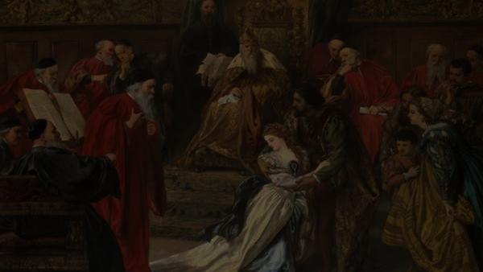

Thank you
Thank You!
Sources:
https://en.wikipedia.org/wiki/King_Lear
King Lear, artist sir John Gilbert-1873
King Lear, artist Robert Hillingford

